Slide 1
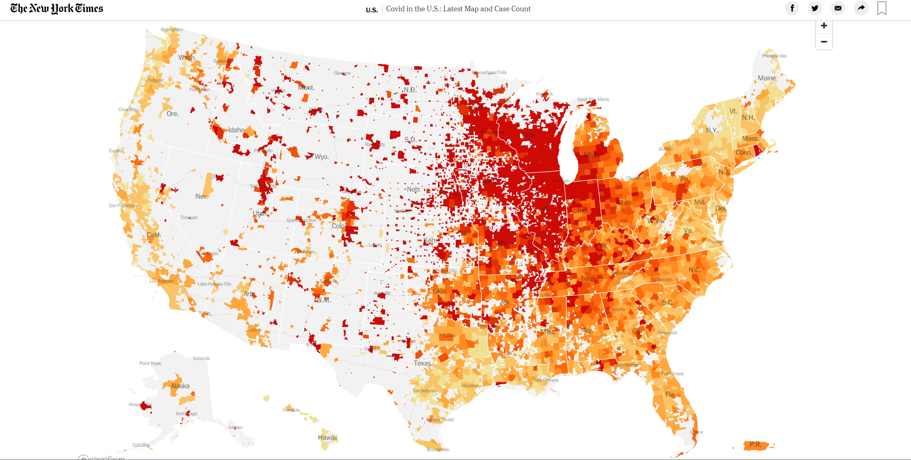
Confirmed Covid19 Cases per Capita in the US (11/09/2020)
Today, 11/09/2020
The US overpassed 10 million Covid19 confirmed cases!!
3% of the total population
Team Members:
Anna Rischitelli
Priya Arunachalam
Nataliia Sokolova
Vincent Durcan
Shadia Duery
Notes:
Our group thought that it would be very interesting to use the newly acquire tools during this bootcamp to take a closer look to what has brought us together this year.
The Covid19 Pandemic.
Today we hit the 10 million marker of Covid19 cases in the US, 3% of our population in 10 months

Slide 2



Do rates of Covid19 differ based on State policies implemented?
Comparison between California and Texas
Notes:
We were very curious to answer with data if “Stronger policies were able to reduce the rates of COVID19 spread”
We decided that a good way to showcase if there were any differences was to compare two states with similar population size that implemented different policies
And that is how we arrived at CA and TX
We were able to get our hands into a great dataset of US Covid19 cases of the John Hopkins University
And information of the State Governments on the dates of implemented measures
-John Hopkins University Covid19 data
-USA.gov land survey
- NY Times
- CA and TX Health Government websites (policy implementation)

Slide 3
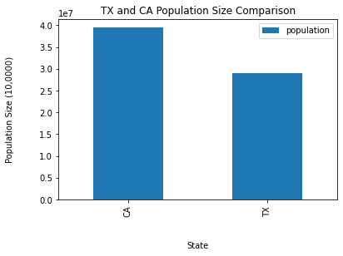
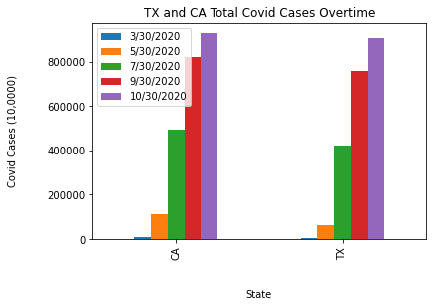
California vs TX: Population, Land Area, Covid19 Cases
<8million
Similar total Covid19 cases
Notes:
In our exploratory analysis we found:
Figure 1 compares the population size between TX and CA. It shows that CA has 8 million more less than TX (equivalent to two time the population of OR)
Figure 2 compares the total number of Covid19 Cases between both states, and shows how both have similar total number of Covid19 cases by now
On the right side there are two-line graphs
Figure 3 shows the rate of increase of Covid19 Cases overtime

Slide 4
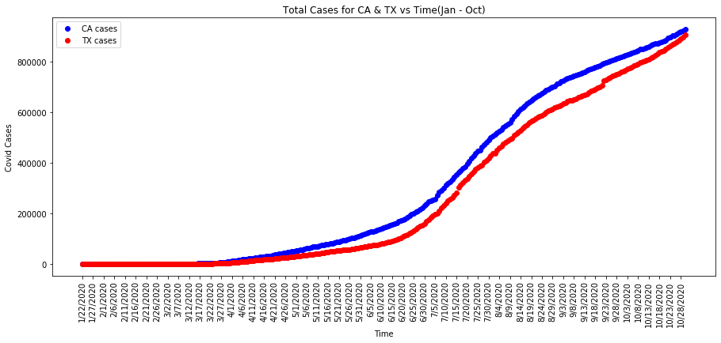
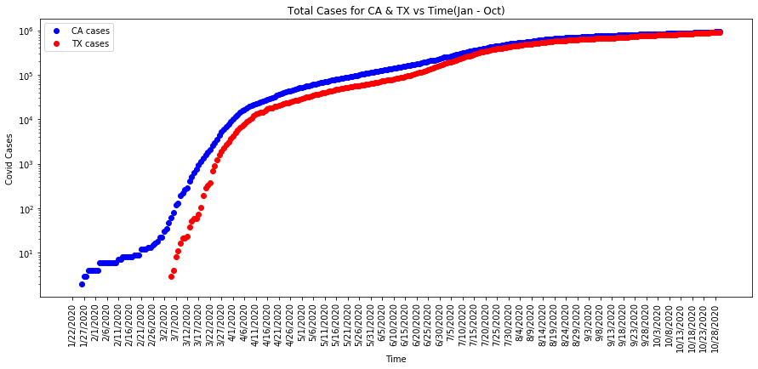
Number of total confirmed Covid19 cases in CA and TX from Jan-Oct 2020
Notes:
In our exploratory analysis we found:
Figure 1 compares the population size between TX and CA. It shows that CA has 8 million more less than TX (equivalent to two time the population of OR)
Figure 2 compares the total number of Covid19 Cases between both states, and shows how both have similar total number of Covid19 cases by now
On the right side there are two-line graphs
Figure 3 shows the rate of increase of Covid19 Cases overtime

Slide 5
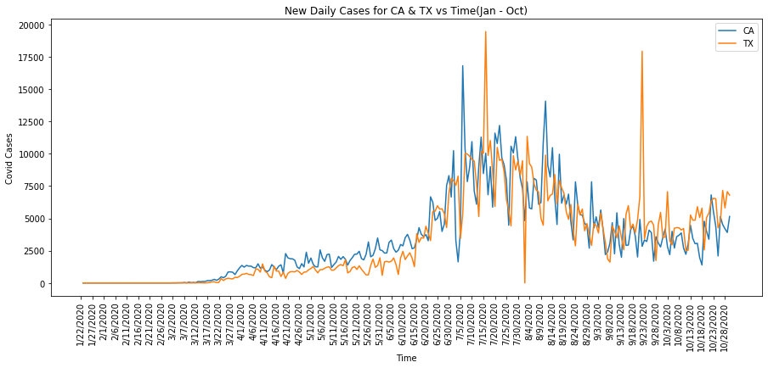
Number of new daily confirmed Covid19 cases in CA and TX from Jan-Oct 2020
TX -- 7/15/2020 -- 20k
TX -- 9/23/2020 -- 18.5K
CA -- 7/5/2020 -- 17k
CA -- 8/9/2020 -- 14.5k
Notes:
In this graph the x-axis shows the timeline of January to October 30, 2020
And the y-axis the daily newly recorded Covid19 confirm cases in CA and TX
This graph shows the first and second spike of Covid19 daily cases in CA and TX
In CA the first spike was in July and the second a month later in August (the first spike had more cases than the second spike)
In TX the first spike was in July and the second spike was in September
Comparing both states TX that has 8 million people less and has less density in their cities, had higher peaks

Slide 6
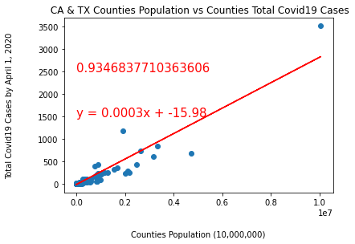
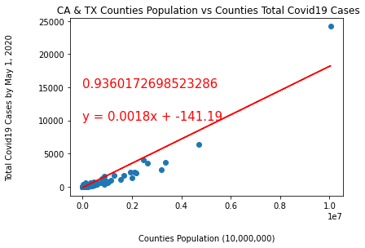
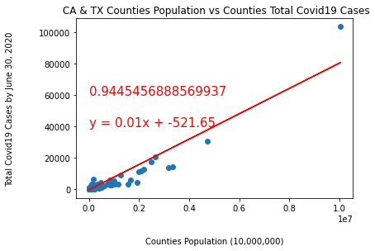
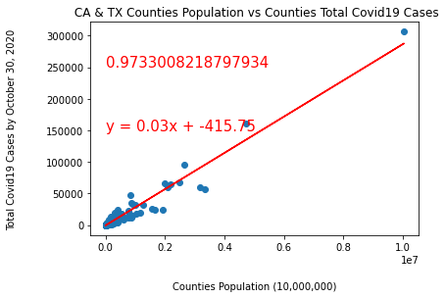
Exploratory Data Analysis: Total Confirmed Cases Related to Population Size
April 1,2020
May 1,2020
June 30,2020
October 30,2020
Notes:
In these set of 4 graphs we plotted on the x-axis the Counties Population in CA and TX against the total number of Covid19 confirmed cases in the same county in April, May, June, and October
Our hypothesis was that in counties with larger populations there would be more covid19 cases
What we were able to find is that there is a strong correlation between population size in a county and the number of Covid19 cases
And the strong correlation was observed overtime while Covid19 cases were increasing
There are more Covid19 case in counties with larger populations

Slide 7
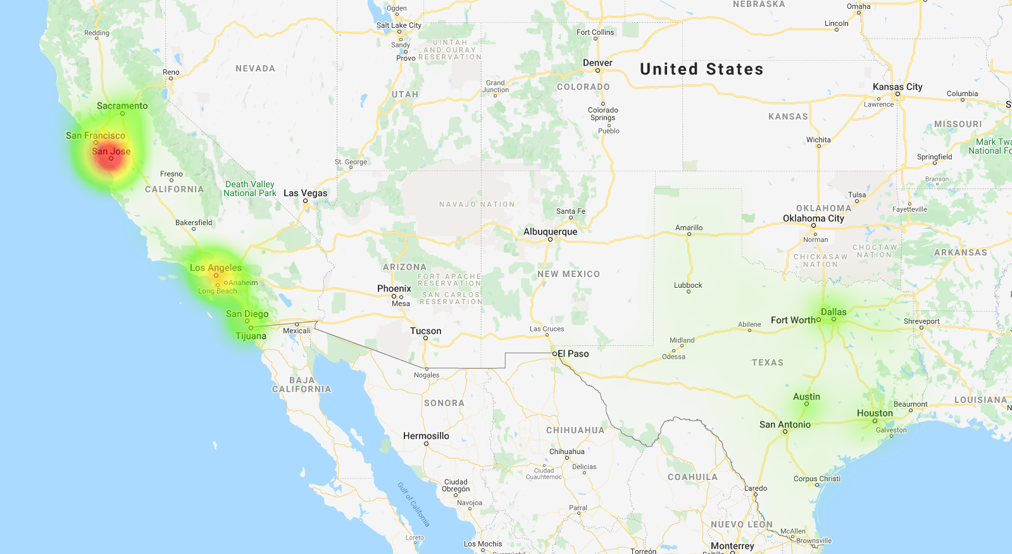

CA- March 19 -State-wide stay-at-home order issued
TX- March 19 -De facto stay-at-home order issued
March 18, 2020

Slide 8
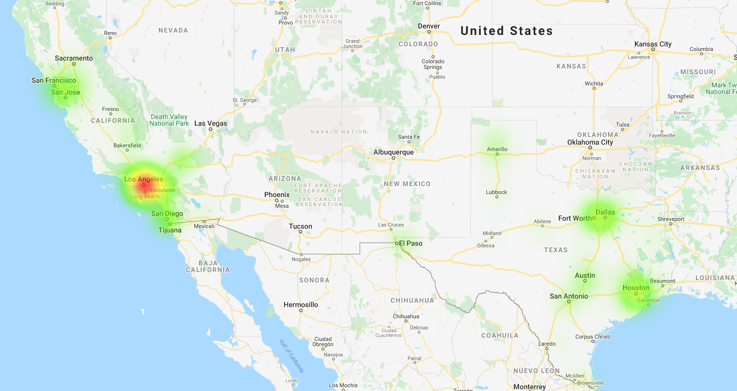
CA- April 1 -Closure of all public and private schools (including institutions of higher education) ordered for the remainder of the 2019–2020 academic year.
TX- April 30 -De facto stay-at-home order expired
April 29, 2020

Slide 9
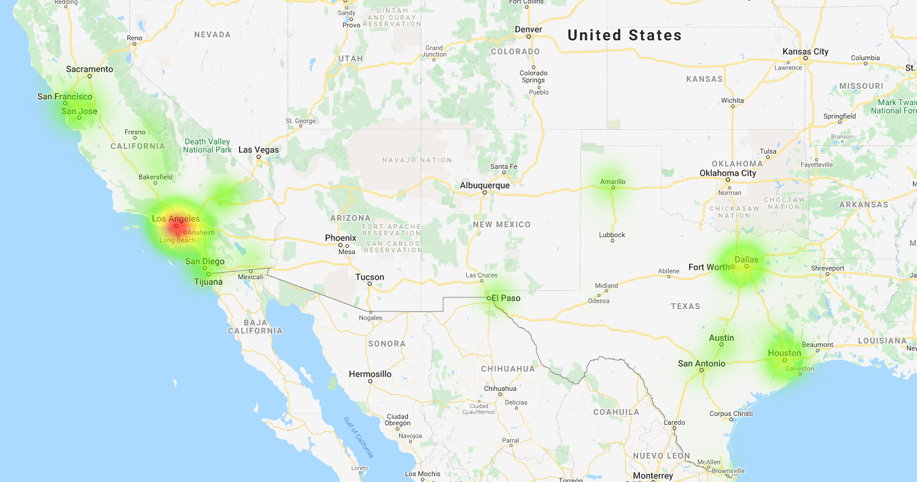
CA-May 7 - State entered Stage 2 of its 4-stage reopening roadmap
CA-May 18 - Businesses that were part of Stage 3 allowed to reopen
TX- May 1 - Start of Phase I: Retail establishments, restaurants, movie theaters, shopping malls, libraries and museums permitted to operate at 25% occupancy.
TX-May 18 -Start of Phase II: Reopening of different types of businesses. Most businesses allowed to operate at 25% occupancy. Restaurant occupancy limit increased to 50%.
May 27, 2020

Slide 10
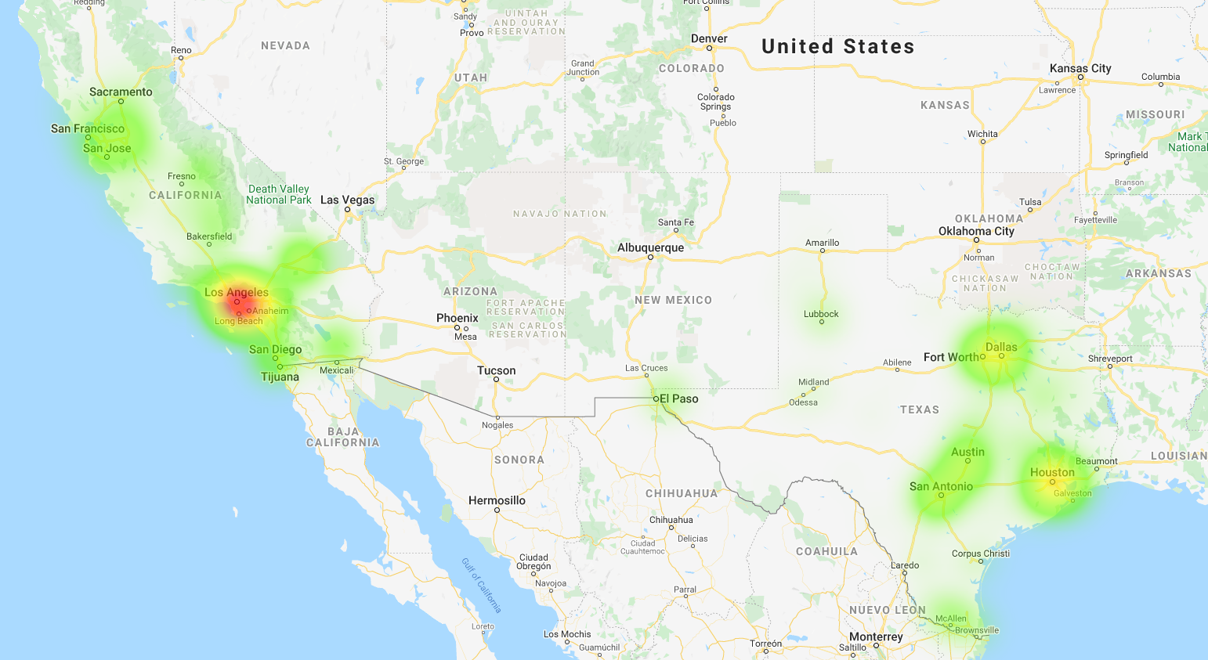
CA- June 28 - Bars ordered to close in several counties
TX- June 26 - Bars ordered to shut down and restaurant capacity limits reduced to 50%. Outdoor gatherings of more than 100 people banned unless government approval received.
June 24, 2020

Slide 11
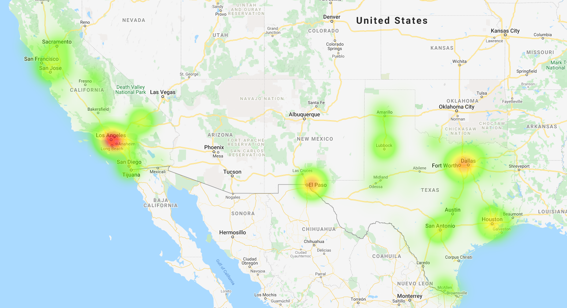
CA - Sep 29 -Majority of population now under "Substantial" or lower BSE restrictions.
October 28, 2020

Slide 12
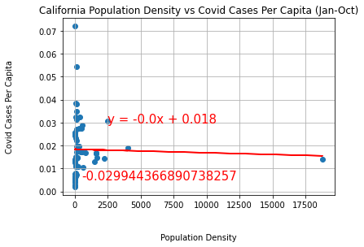
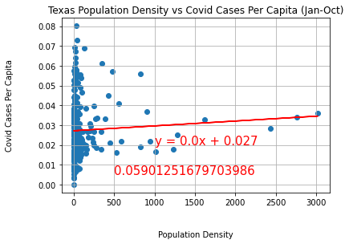
State | Population (million) | Difference in Population | Land Area (Sq. Mi.) | Difference in Land Area | People per Sq. Mi.
CA | 37 | CA 8 million more | 155,779 | TX 105K Sq. Mi. more | 254
TX | 29 |  | 261,267 |  | 105
San Francisco
Notes:
After observing in our exploratory analysis that there was a strong correlation between county population size and the number of covid19 cases
We hypothesized that covid cases were correlated to population density
We normalized the data and plotted Covid Cases Per Capita against Population density
The data showed that population density is not correlated to Covid Cases per Capita in both states
Then we decided to maybe view the data in a different way, instead of using scatter plots using bar graphs

Slide 13
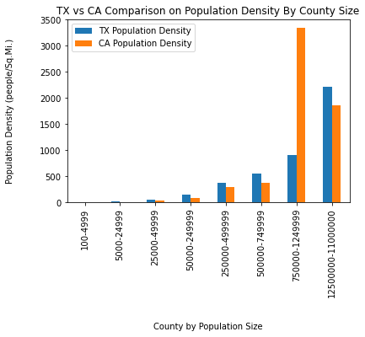
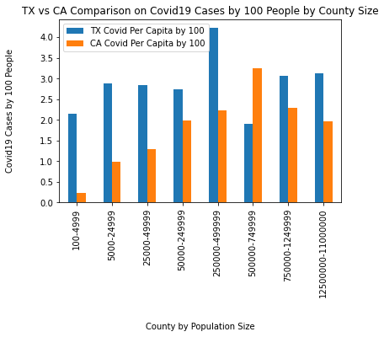
Population Density and Covid19 per 100 people
Rural
Urban
Rural
Urban
Notes:
On these set of bar graphs we grouped counties by population sizes, from small to large
Then, we went one step further and divided the population groups in Rural and Urban areas
A population under 50 thousand people is considered Rural, and larger than 50 thousand Urban
On the graph on the left population group sizes were plotted against population density (people by Sq.Mi)
As expected, rural areas have lower population densities than urban areas in both States
And this large orange bar represents the and outlier, the city of San Francisco, that is densely populated area
On the graph on the right population group sizes were plotted against Covid19 Cases by 100 people
We can observe that TX had more cases per capita in Rural and Urban setting the exception of one

Slide 14


Revisit Study Question
Do rates of Covid19 differ based on State policies implemented?
Study Findings
CA had more stringent policies than TX
Regardless of the policies implemented the spread is inevitable
By implementing precursory measures you can slow down the spread
Stronger policies reduce the Covid19 cases per capita and reduces the spread

Slide 15


Limitations
Covid19 testing
Policy implementation and execution
Time constraints
Things we would do different next time
Include more states in the comparison
Compare to other country policies

Slide 16

Thank You
Questions?

